Slide 1
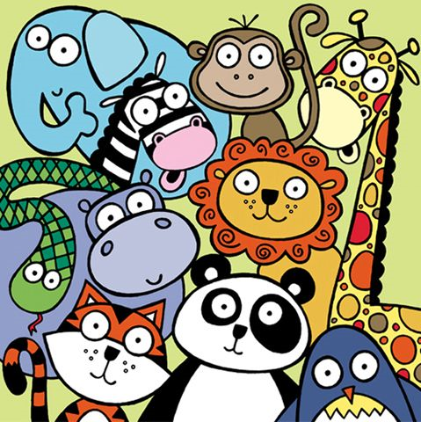
Name that animal!

Slide 2
Instructions
One student stands back to the screen. The other students have to help him guess the animal using the vocabulary they learned related to the animal.
You cannot name the animal.
You cannot mimic the sounds or the gestures of the animal.
You cannot use french!

Slide 3
Ready??

Slide 4
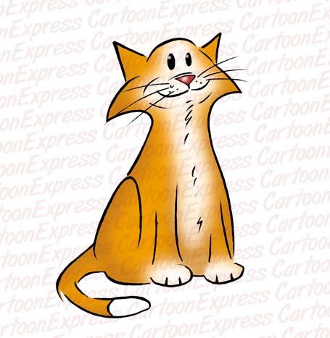
The animal is…

Slide 5
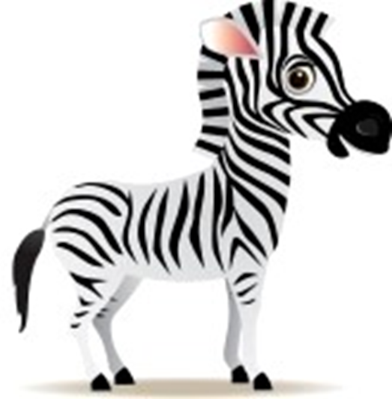
The animal is…

Slide 6
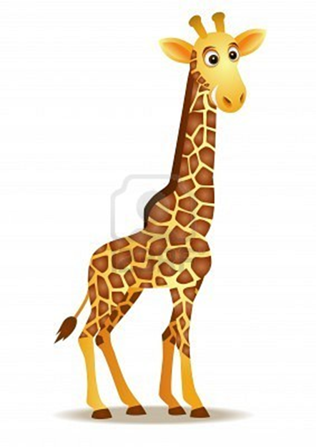
The animal is…

Slide 7
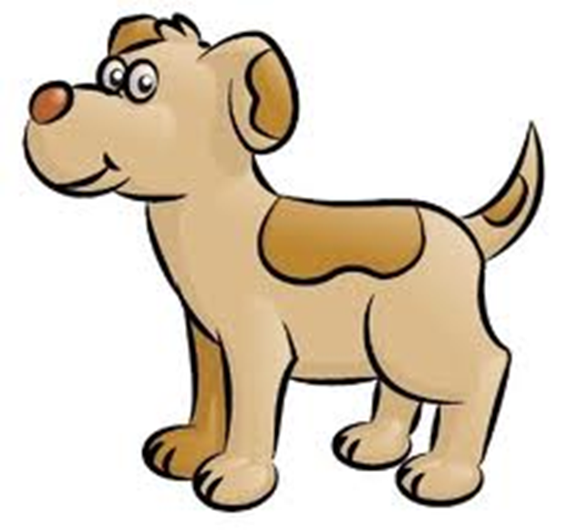
The animal is…

